Slide 1
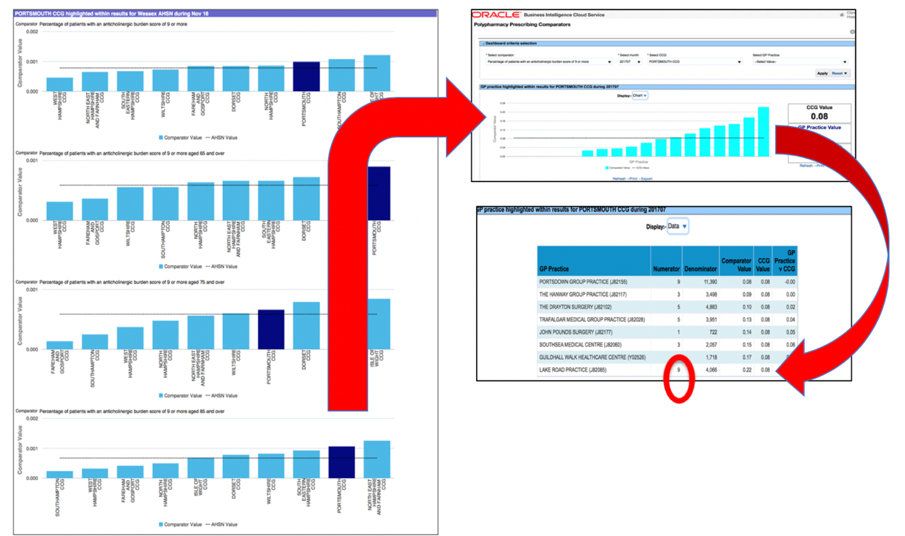
What does the tool look like?
Know your data.
Find patients at risk.
Make a difference!
STEP 1
STEP 2
STEP 3
Look at your local polypharmacy data via ePACT 2 and select an area of concern
Complete the “request procedure” to access the NHS numbers of the patients in your practice deemed to be at risk and invite those patients for a medication review
NE Hampshire and Farnham CCG supported every practice to do this well and have demonstrated a decrease in all polypharmacy comparators at double the national average rates!
Portsmouth CCG percentage of patients with Anticholinergic Score of 9 or more
9 patients at significant risk. Practice can now identity these pts and then review
To access your data go to:
nhsbsa.nhs.uk/epact2/dashboards-and-specifications/medicines-optimisation-polypharmacy
For more resources go to
https://wessexahsn.org.uk/projects/160/polypharmacy-what-next-planning-for-wessex

